Slide 1

PLS 206 Applied Multivariate Modeling in Agricultural and Environmental Sciences
Structural Equation Modeling (SEM)

Slide 2
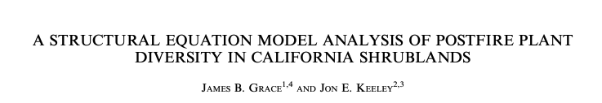
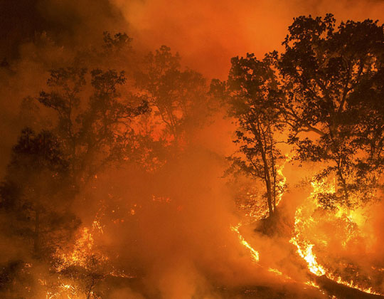
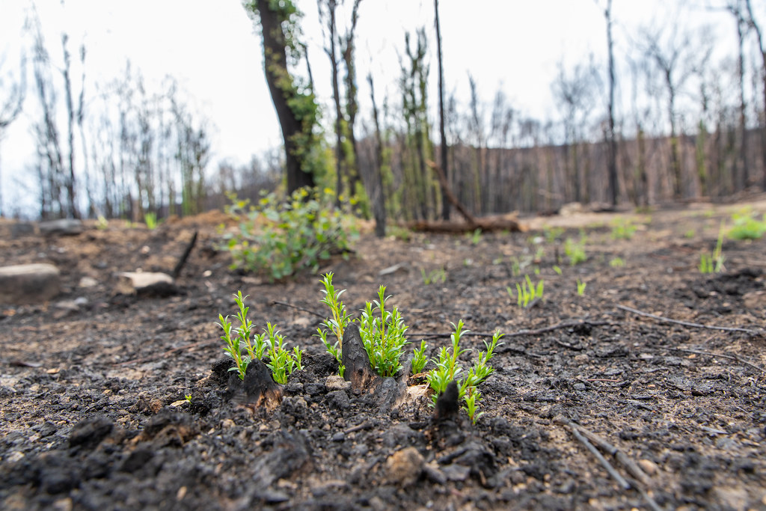
What factors affect vegetation recovery to fire?
UC ANR

Slide 3
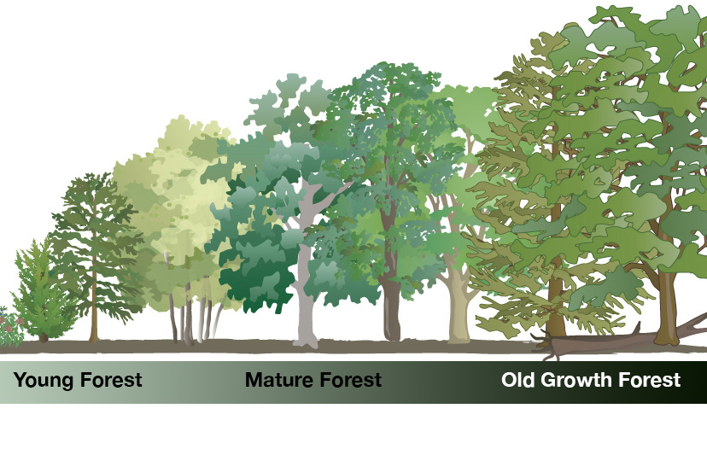
Age
Fire severity (firesev)
Cover

Slide 4
Age
Fire severity (firesev)
Cover
lm(cover ~ age + firesev)

Slide 5
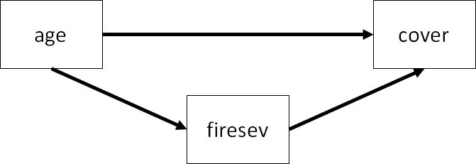
Age
Fire severity (firesev)
Cover
lm(cover ~ age + firesev)

Slide 6
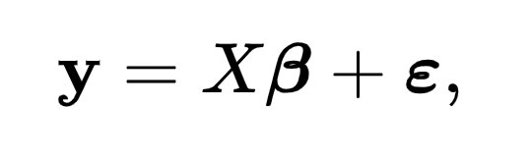
Age
Fire severity (firesev)
Cover
β_{age}
ε_{(residual error)}
β_{0(intercept)}
β_{firesev}
lm(cover ~ age + firesev)

Slide 7
Age
Fire severity (firesev)
Cover
How can we represent this in a single model?
Path of indirect effect of age
Age does not have a direct effect on cover response but has indirect effect by influence fire severity?

Slide 8
Age
Fire severity (firesev)
Cover
How can we represent this in a single model?
ε_{(residual error)}
SEM:
𝛾
β
firesev ~ age
cover ~ firesev
ε_{(residual error)}
Path of indirect effect of age
Age does not have a direct effect on cover response but has indirect effect by influence fire severity?

Slide 9
Age
Fire severity (firesev)
Cover
How can we represent this in a single model?
Path of direct effect of age
Path of indirect effect of age
Age has a direct effect on cover response and has indirect effect by influence fire severity?

Slide 10
Age
Fire severity (firesev)
Cover
How can we represent this in a single model?
𝛾
ε_{(residual error)}
𝛾
β
Structural equation model (SEM)!
firesev ~ age
cover ~ firesev + age
ε_{(residual error)}
Age has a direct effect on cover response and has indirect effect by influence fire severity?

Slide 11
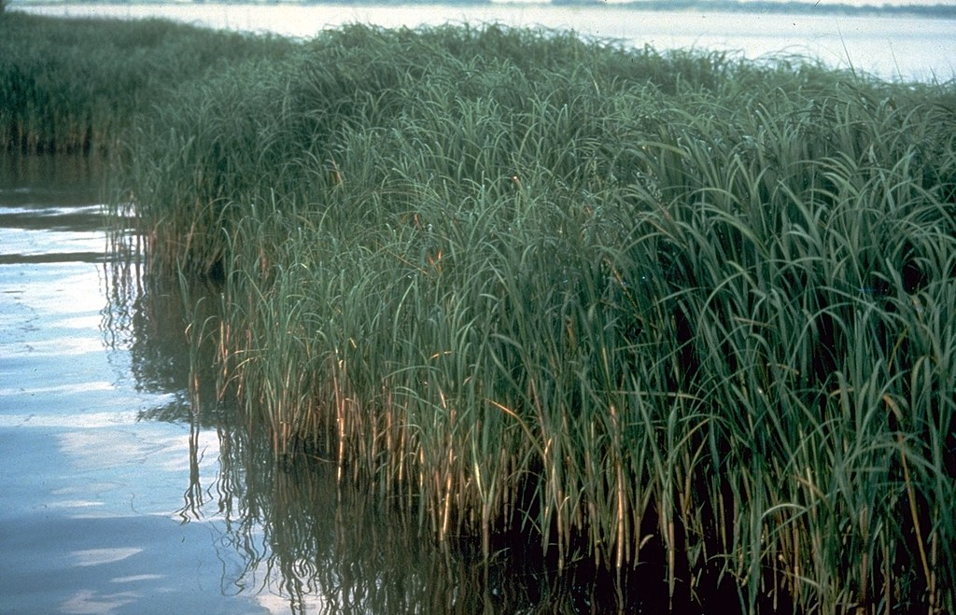

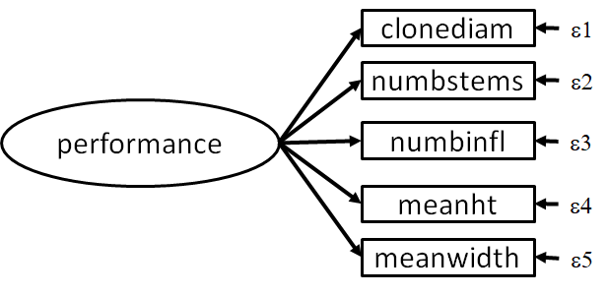
Latent variable

Slide 12

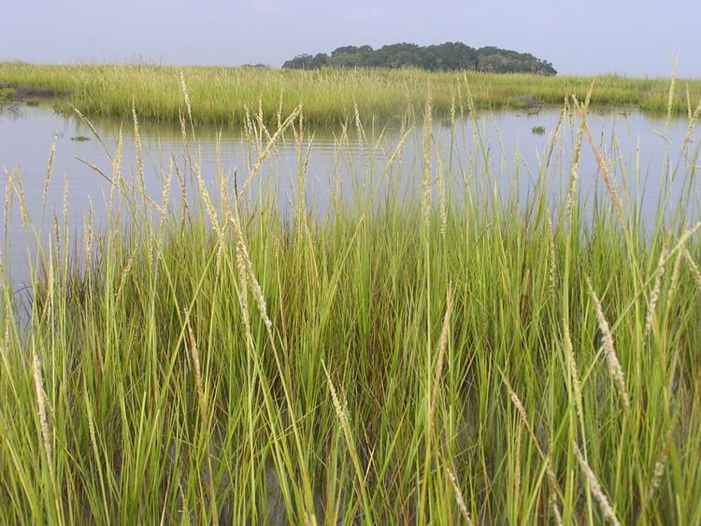


Does genetic distance (genetic difference between introduced plants and local populations) affect performance in ecological restoration?

Slide 13
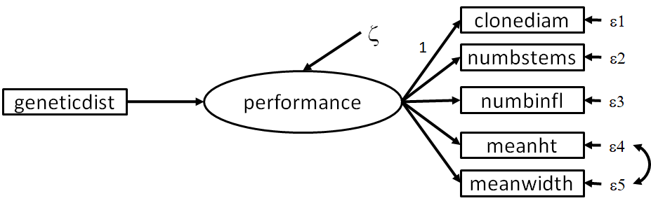
Genetic diversity
“Performance”

Slide 14
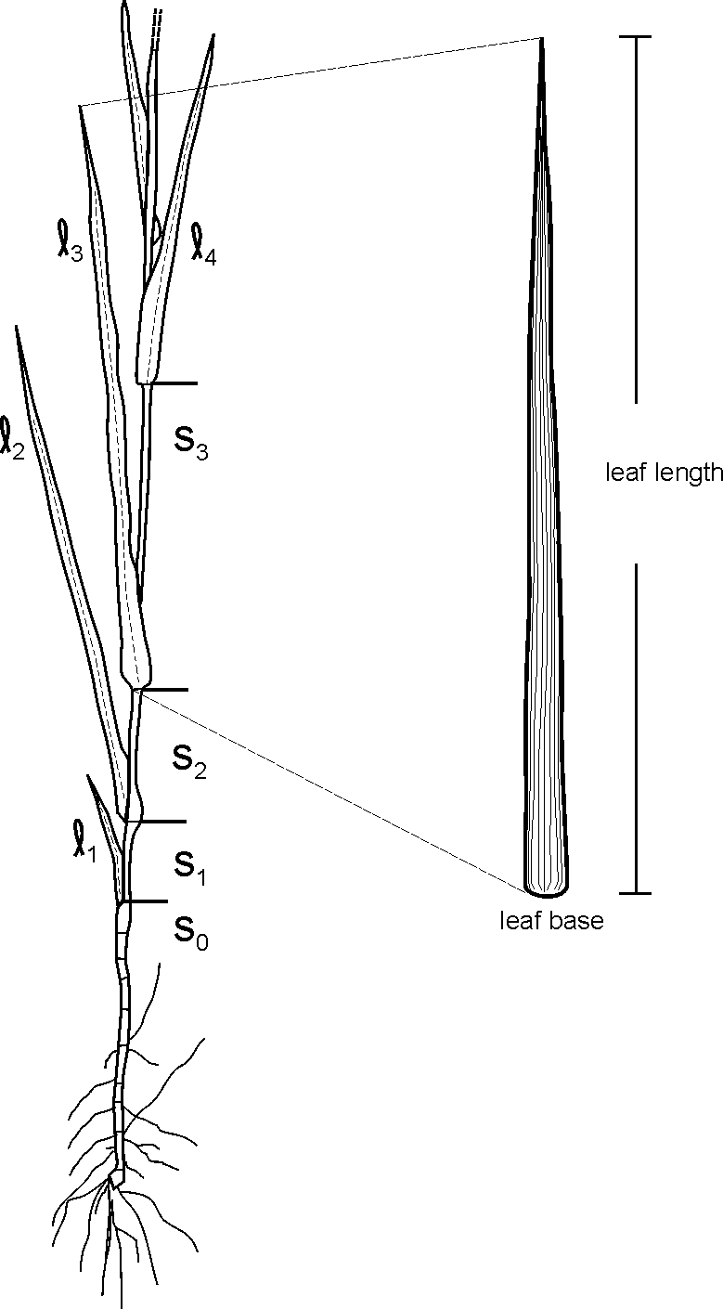
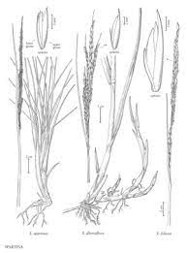
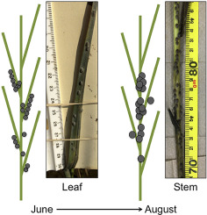
Genetic diversity
“Performance”
”Performance” is a “latent” trait that is manifest in the measurement of lots of different traits?
performance =~ stems + infls + clonediam + leafht + leafwdth
performance ~ geneticdist

Slide 15
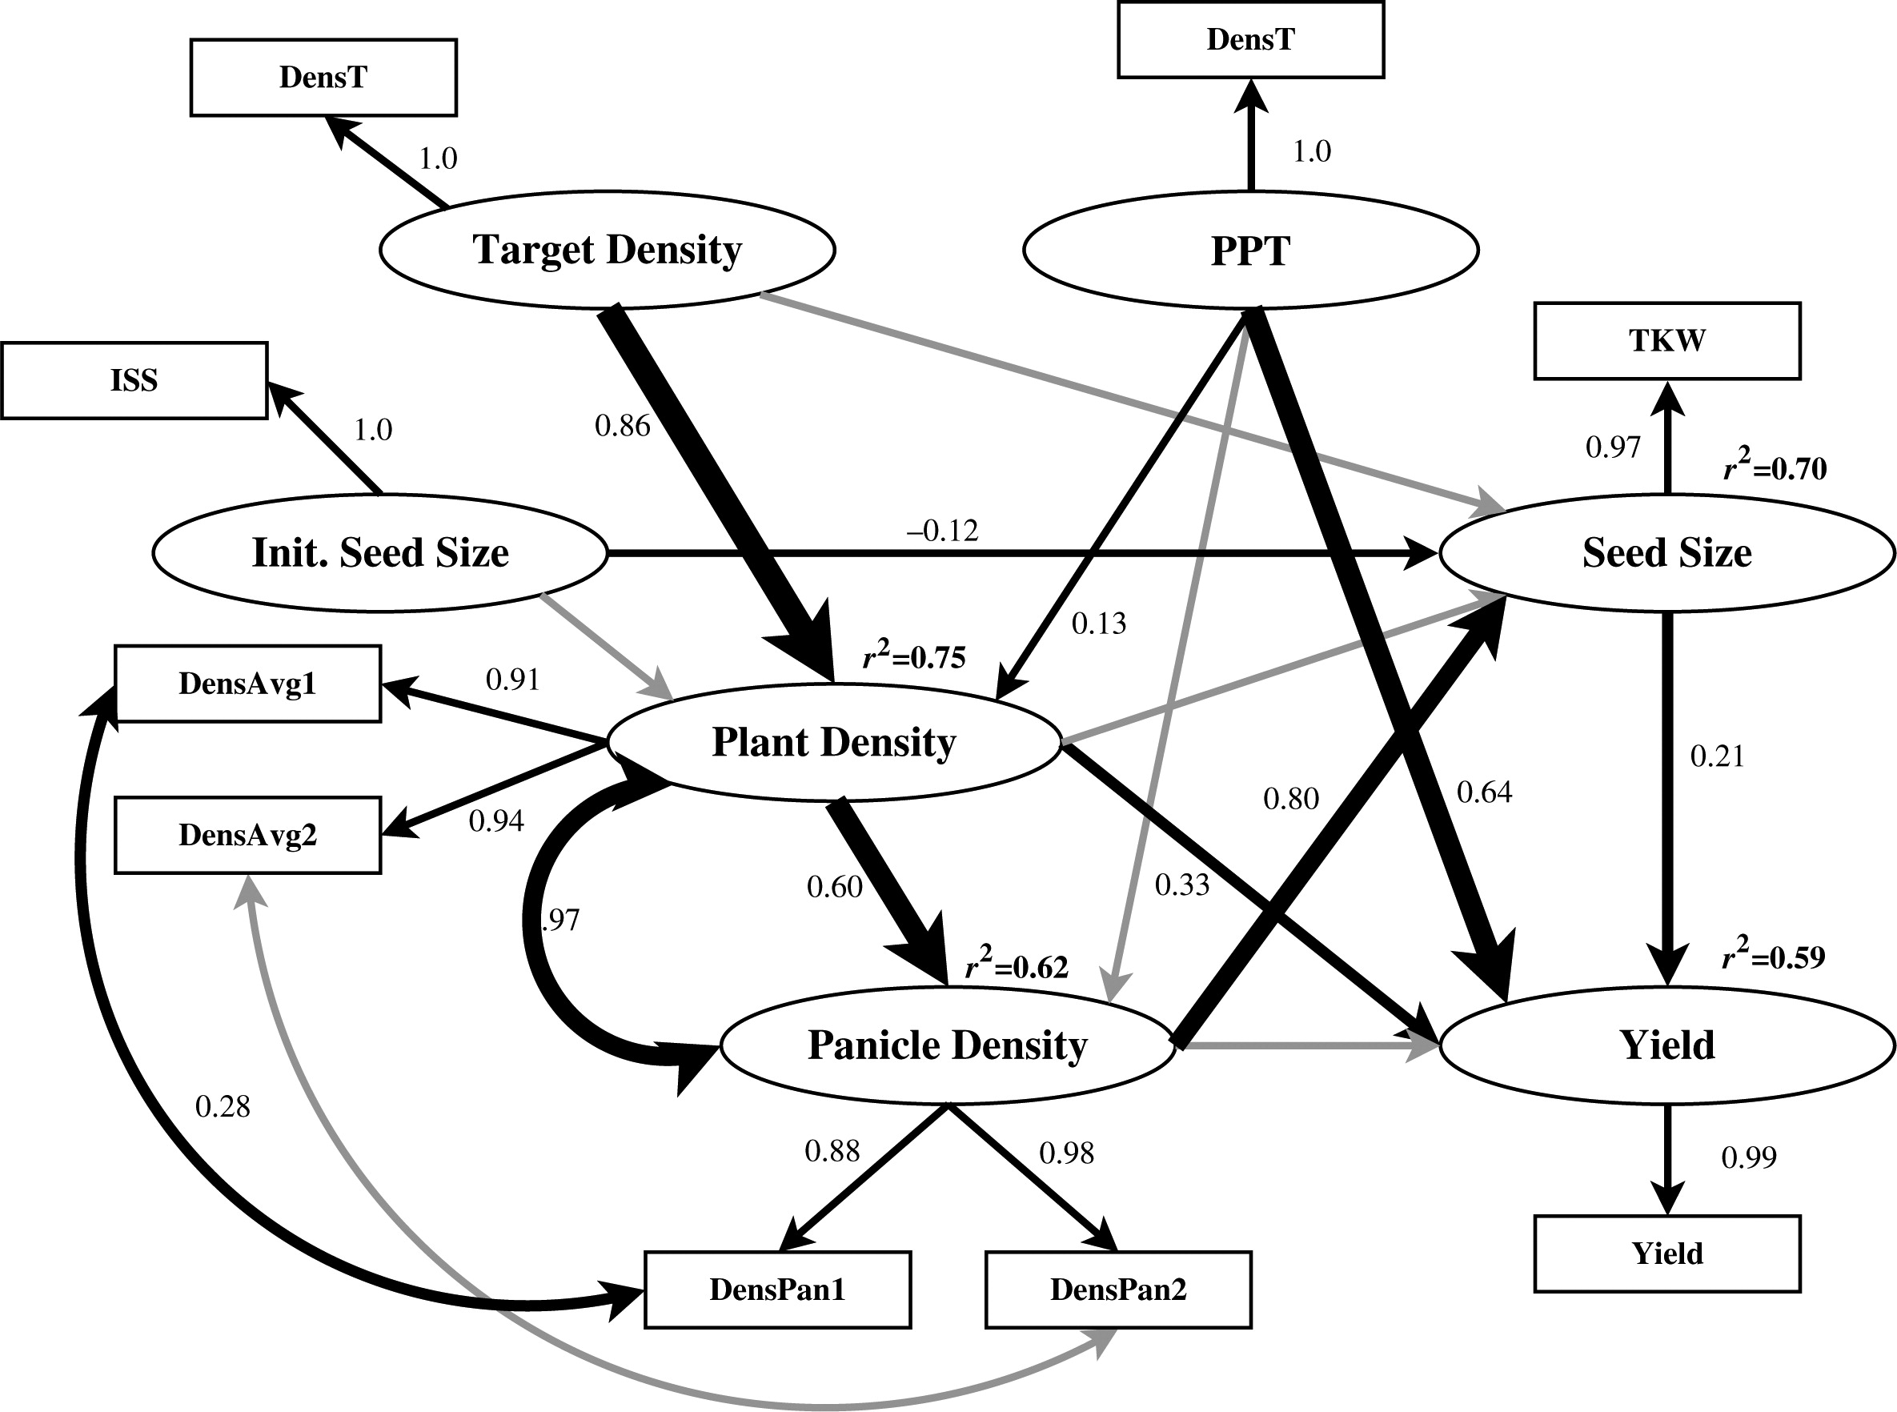
Today:
Introduction to Structural Equation Modeling (SEM)
Comparison of SEM to Linear Regression
How to model direct and indirect effects with SEM
Latent variables and how to model them
How to interpret figures like these….

Slide 16
“AN INTRODUCTION TO STRUCTURAL EQUATION MODELING FOR ECOLOGY AND EVOLUTIONARY BIOLOGY”

Slide 17
“Structural equation modeling is among the fastest growing statistical techniques in the natural sciences, thanks in large part to new advances and software packages that make it broadly applicable and easy to use.”
Jon Lefcheck, Smithsonian Institution

Slide 18
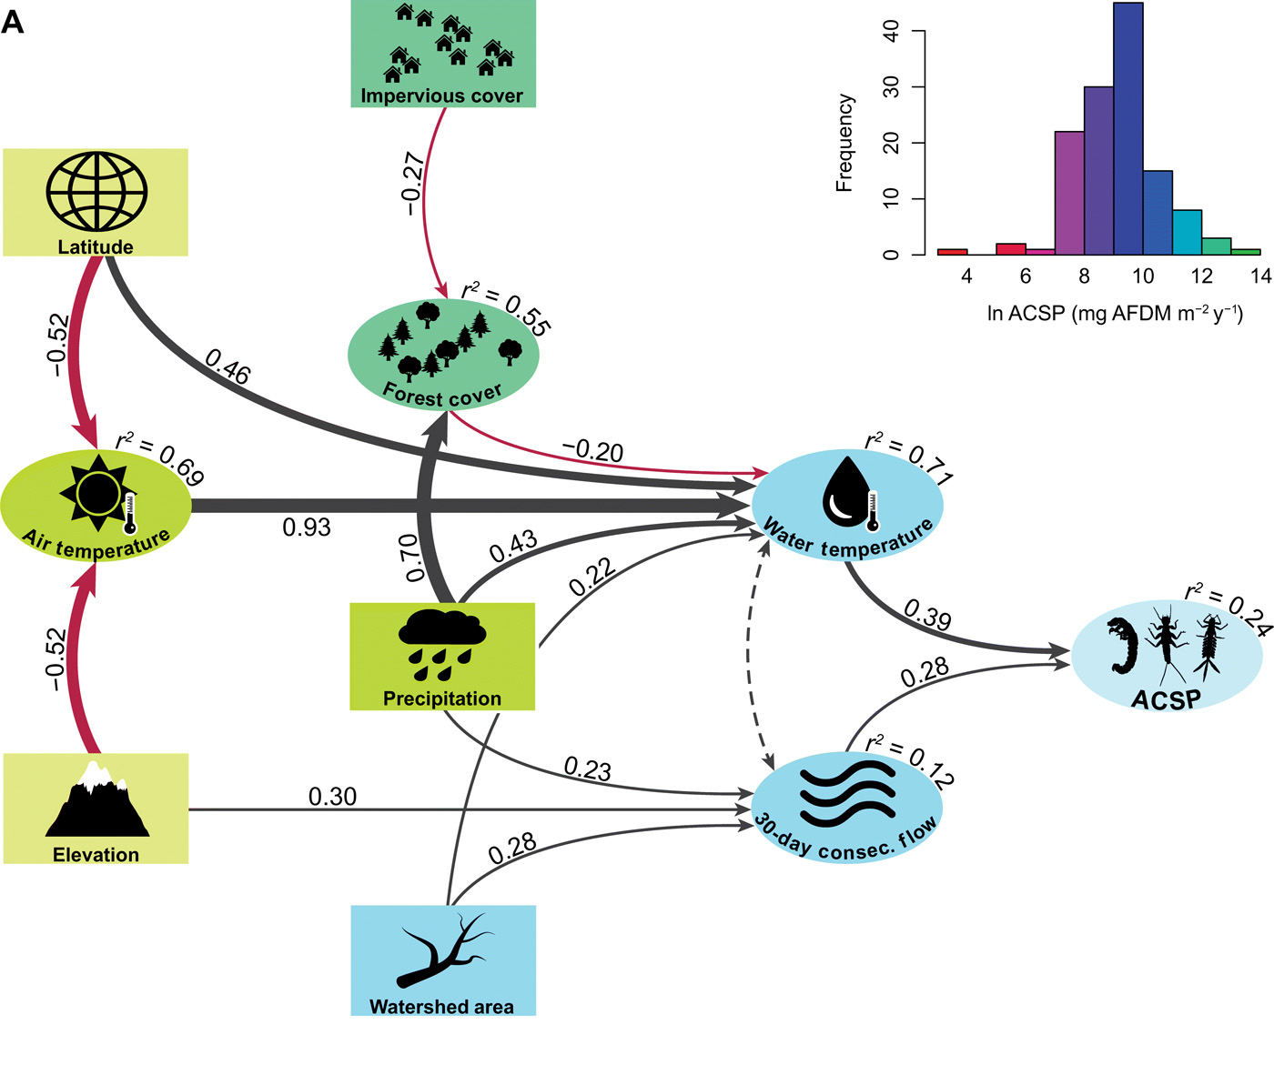

“Structural equation modeling is among the fastest growing statistical techniques in the natural sciences, thanks in large part to new advances and software packages that make it broadly applicable and easy to use.”
Jon Lefcheck, Smithsonian Institution

Slide 19

“AN INTRODUCTION TO STRUCTURAL EQUATION MODELING FOR ECOLOGY AND EVOLUTIONARY BIOLOGY”

Slide 20
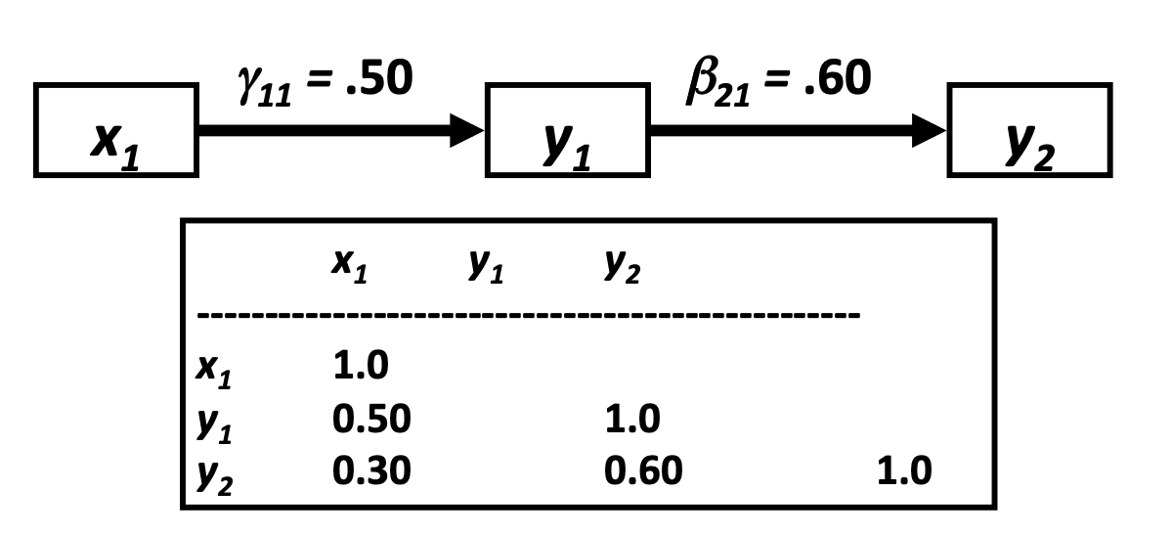
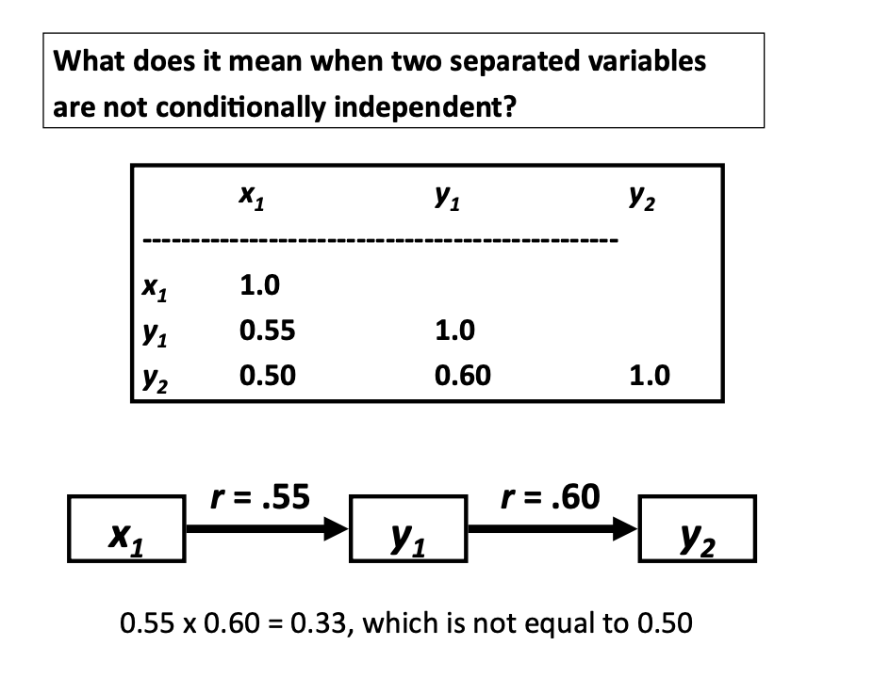
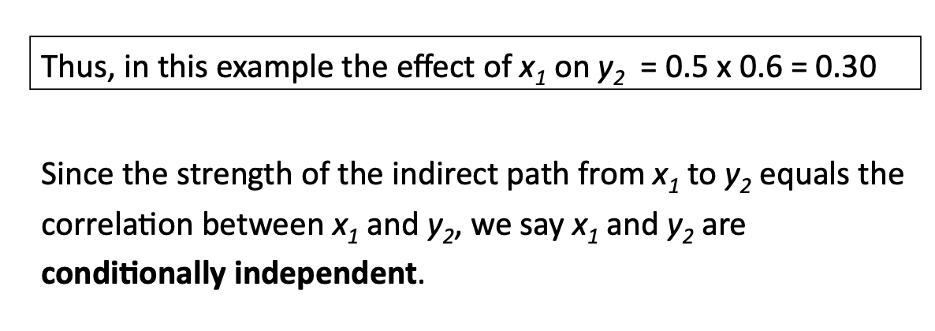
Scaled Covariance matrix (correlation matrix) in observed data:

Slide 21
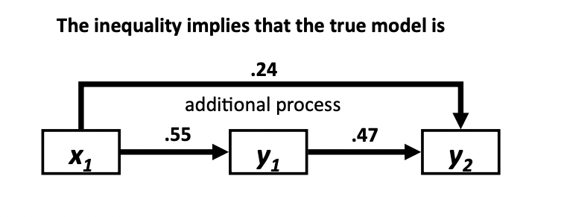
0.55 x 0.47 + .24 = 0.5

Slide 22
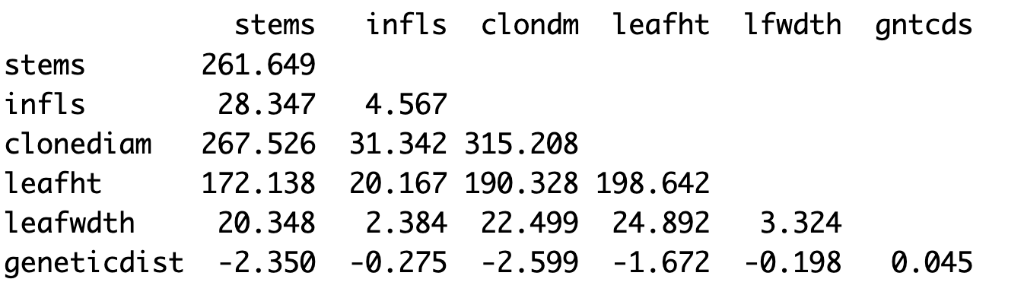
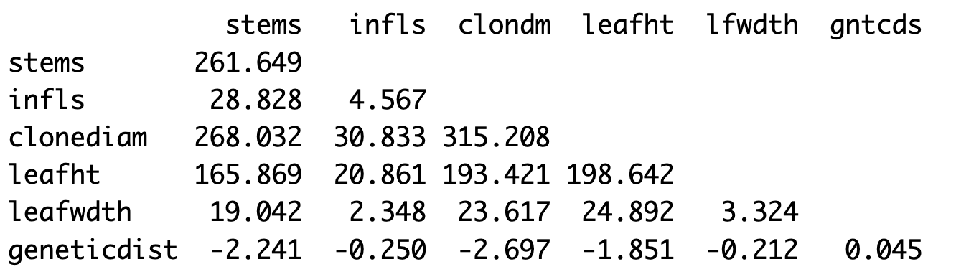
How SEM “fits” the data
Covariance matrix in observed data:
Diagonals are variance
Minimize difference
Covariance matrix in implied by the model:

Slide 23
Are the residuals between fitted and observed covariances larger than expected?
“AN INTRODUCTION TO STRUCTURAL EQUATION MODELING FOR ECOLOGY AND EVOLUTIONARY BIOLOGY”

Slide 24
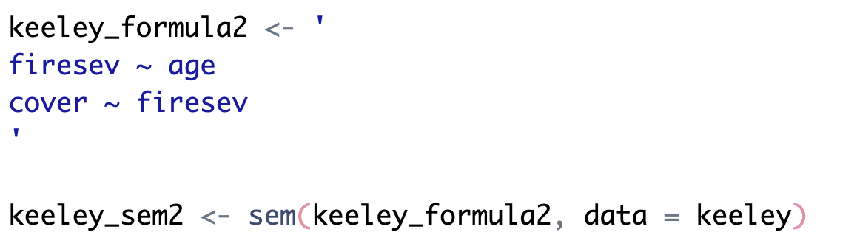
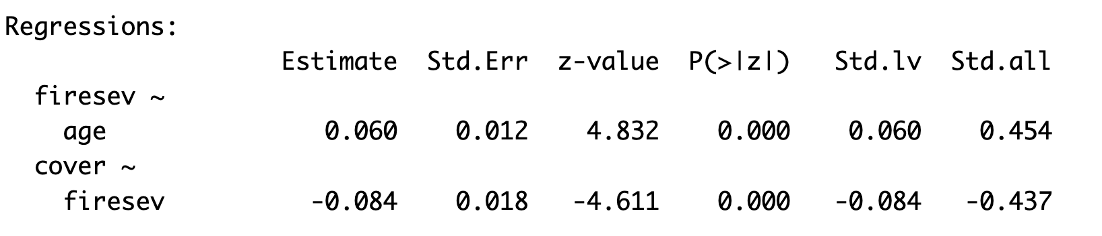
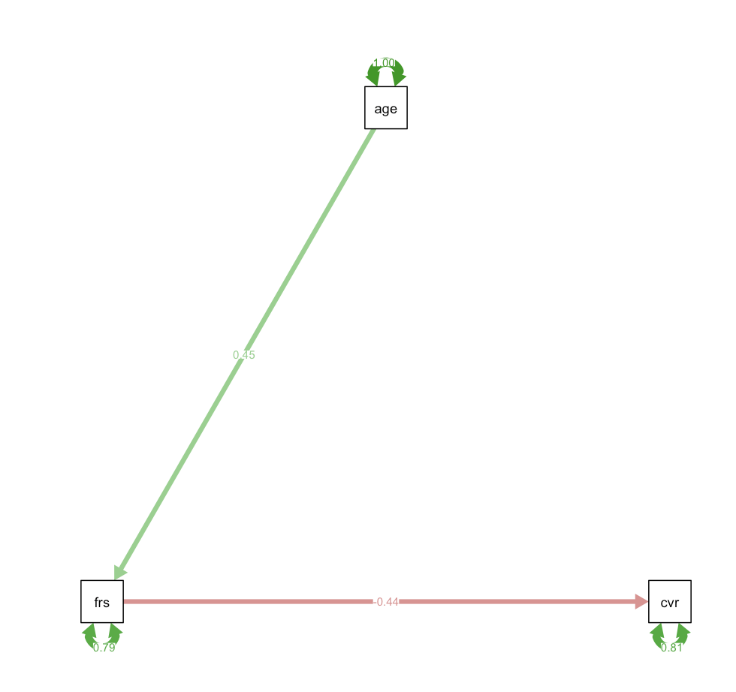
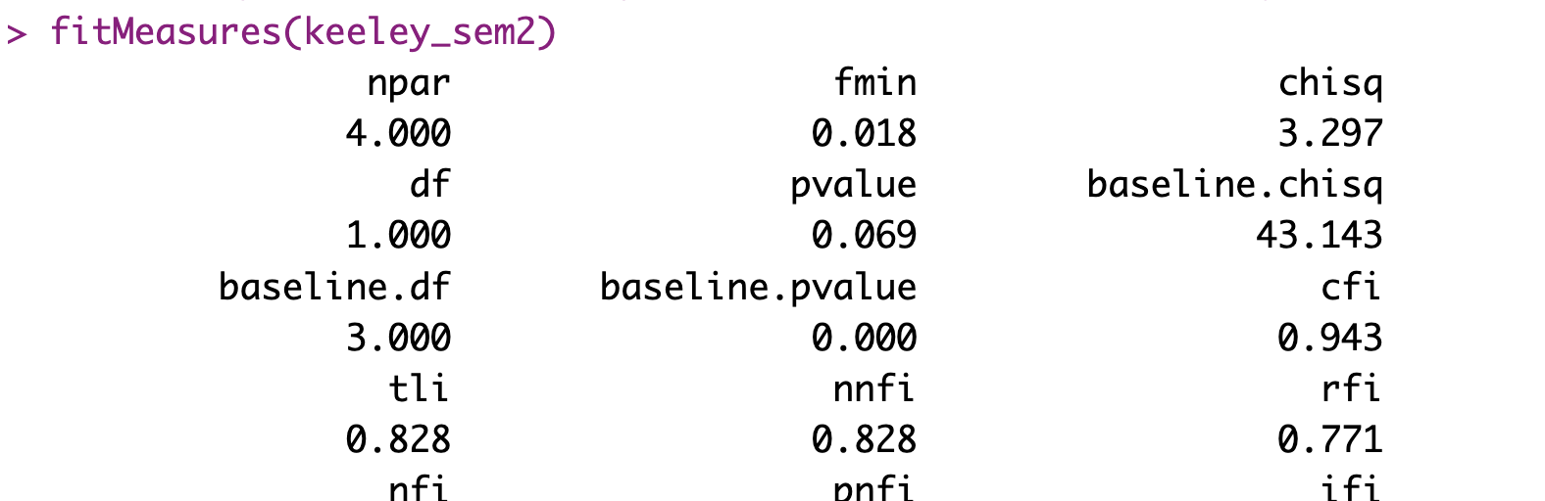
Making SEM models
Age
Fire severity (firesev)
Cover
Summarizing
ε
𝛾
β
Visualizing
Evaluating fit
ε
Age does not have a direct effect on cover response but has indirect effect by influence fire severity?

Slide 25
“Performance”

Slide 27
“Performance”

Slide 28
“Performance”

Slide 31
Caution!

Slide 32
“Performance”

Slide 33
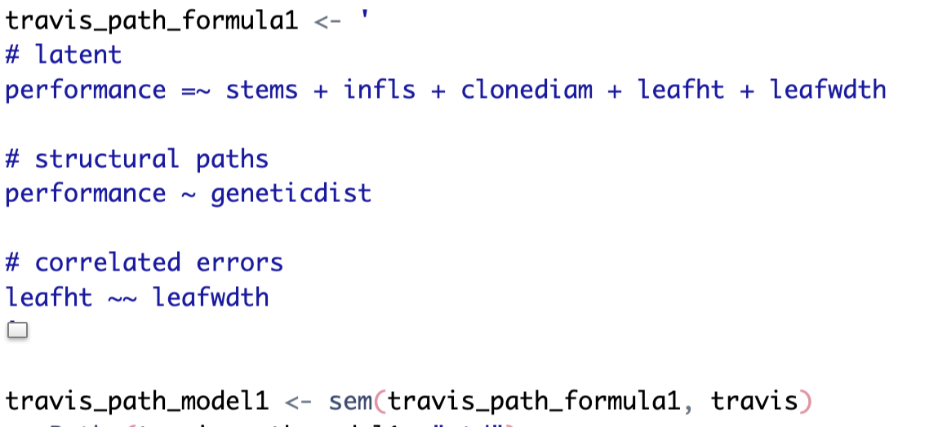
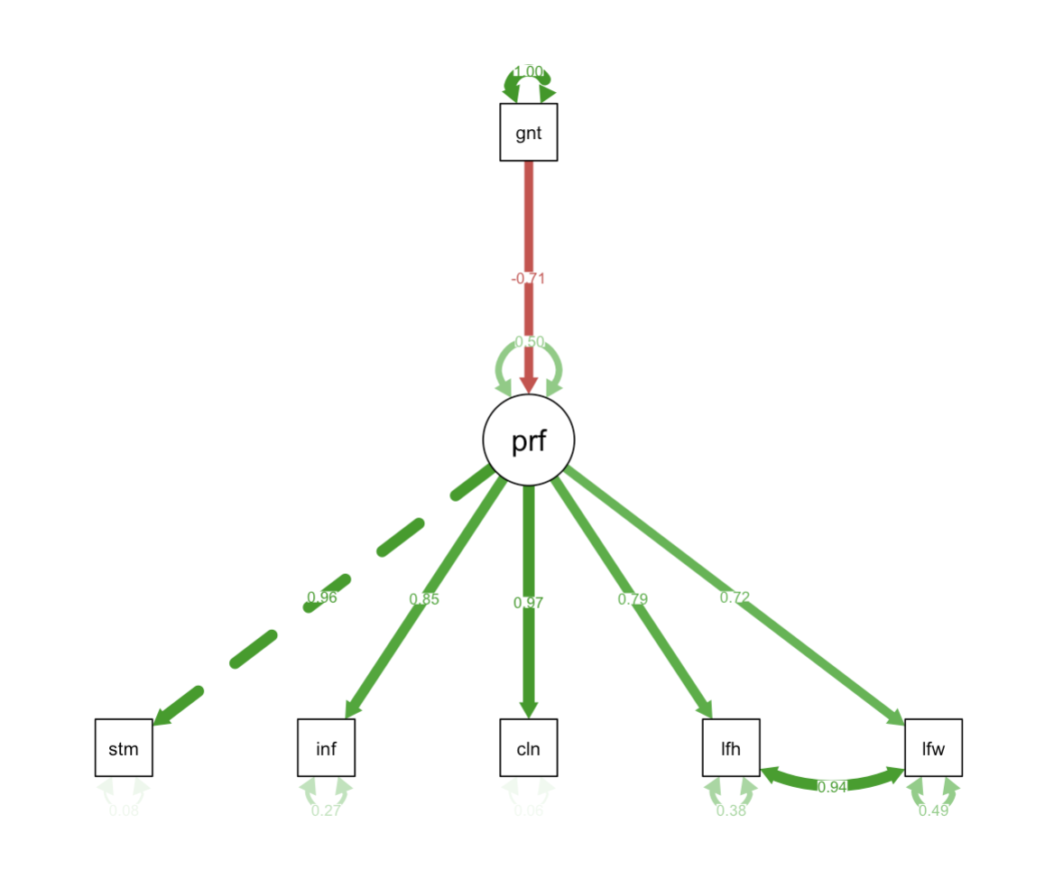
Genetic diversity
“Performance”
(Latent variables are diagramed as circles)

Slide 35
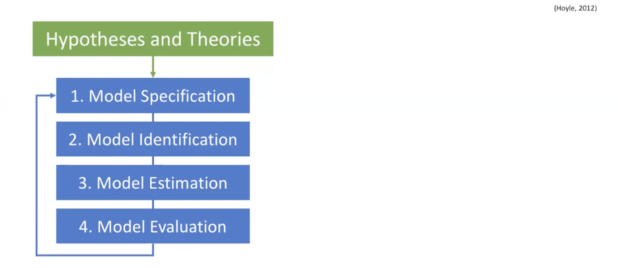

Slide 36
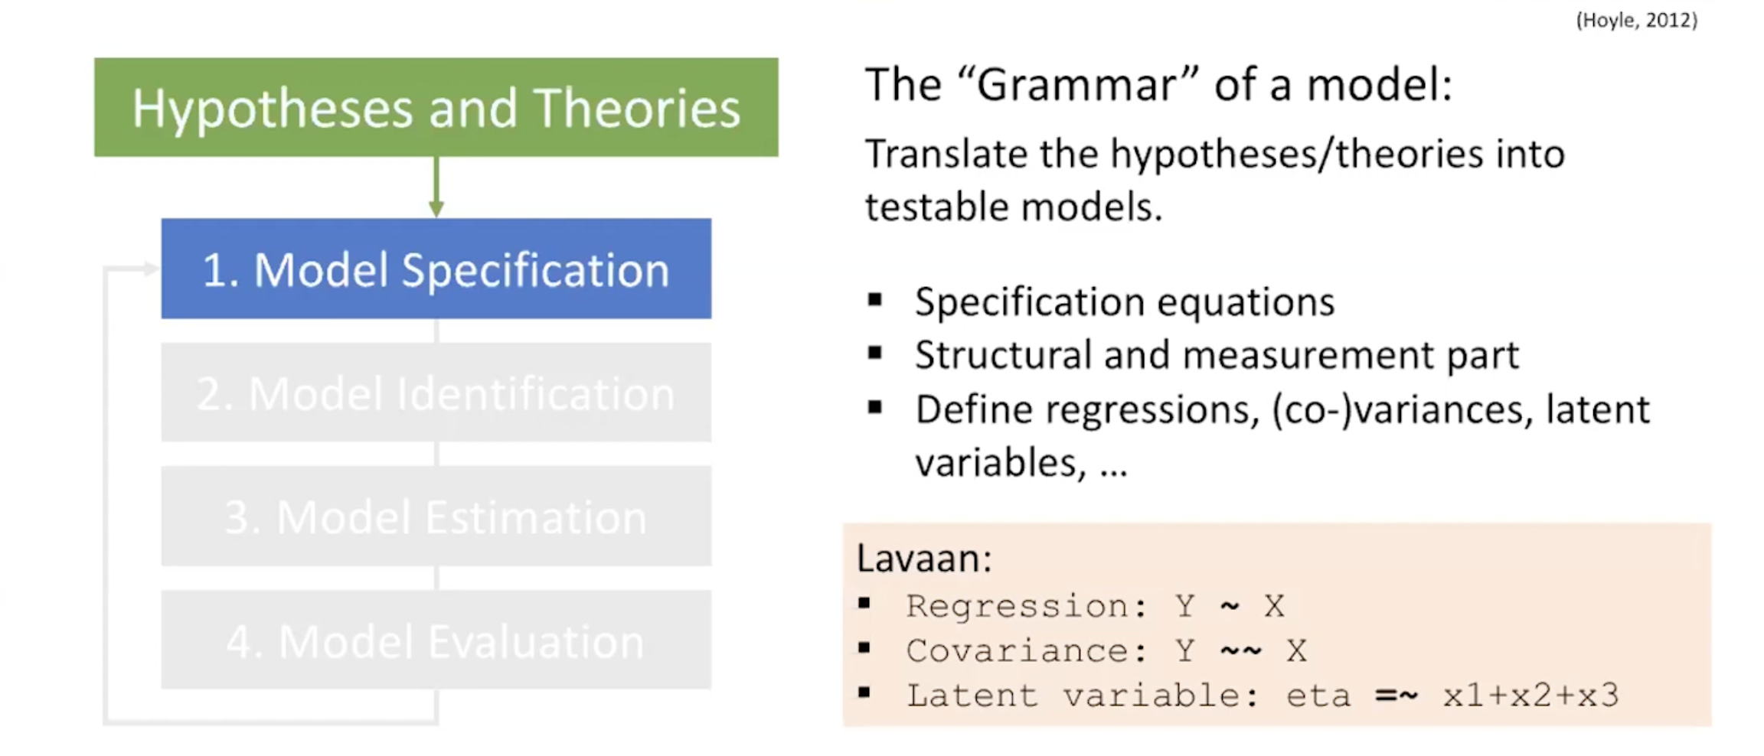

Slide 37
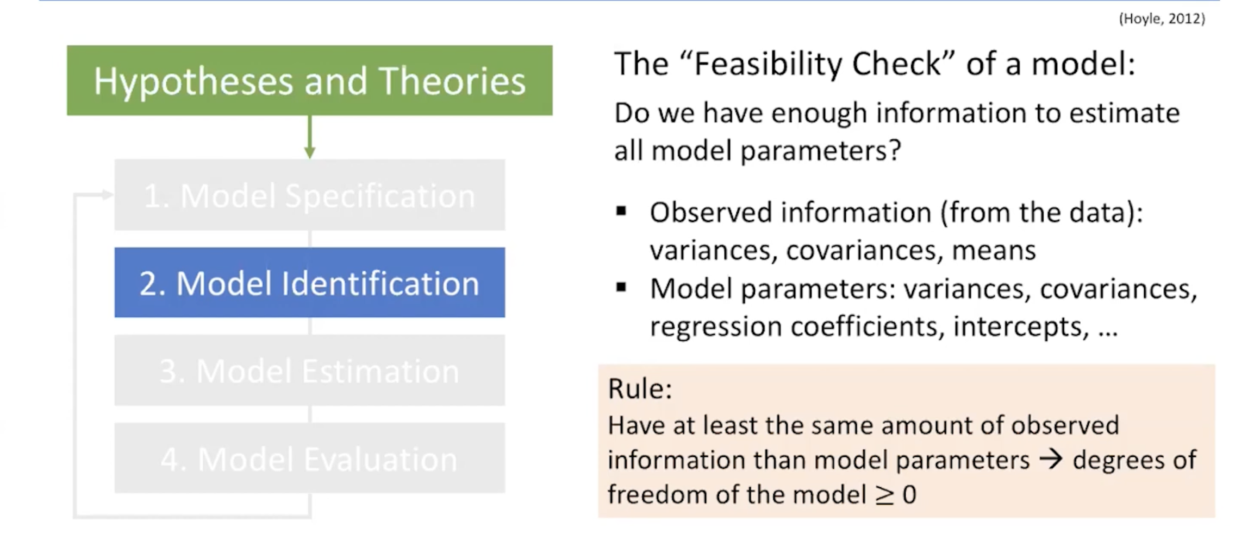

Slide 38
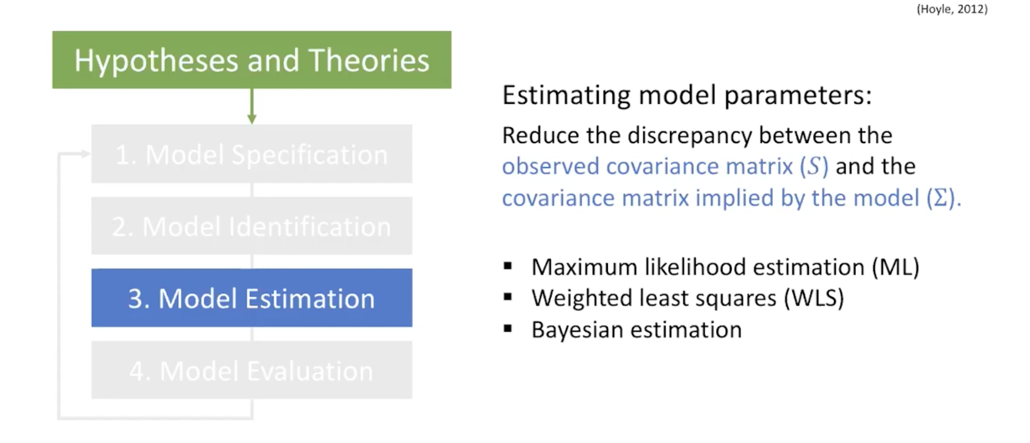

Slide 39
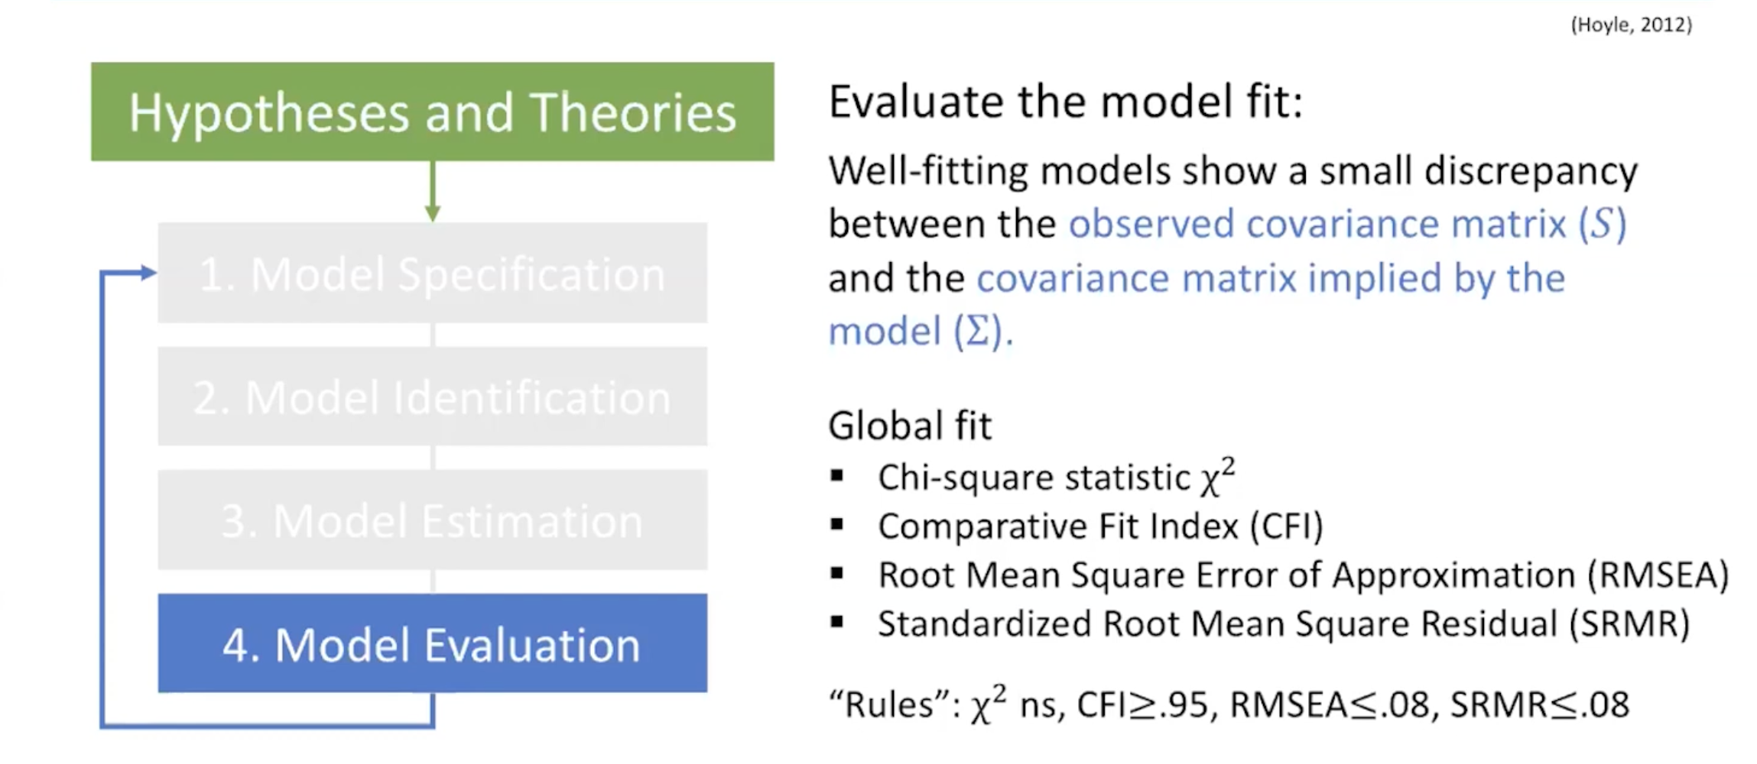

Slide 40
Genetic diversity
“Performance”
(Latent variables are diagramed as circles)

Slide 41
Resources to learn more
https://jslefche.github.io/sem_book
Free online book, explaining SEM in more detail, with R code

